Slide 1

Pizza Sales Analysis Using SQL
(Unlocking Order Volumes & Revenue Insights)

Slide 2
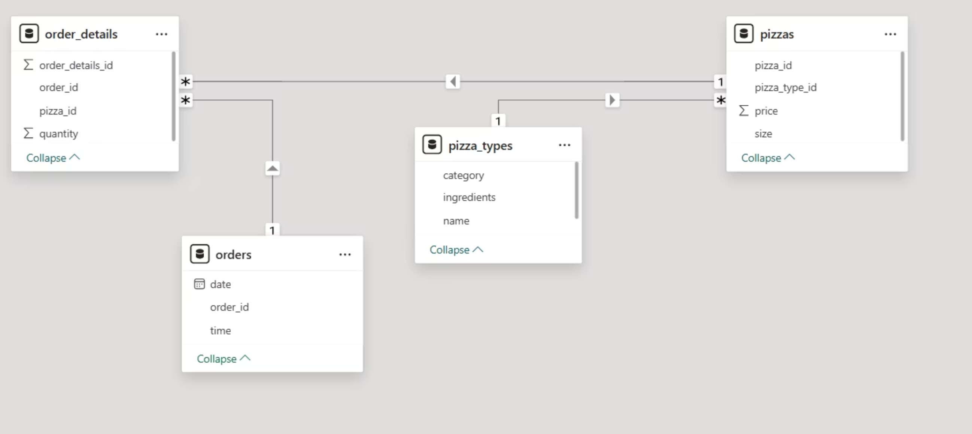
Project Overview: Data Schema
This project employs SQL and MySQL workbench to analyse pizza sales data of over 48,000 transactions, extracting insights from customer orders, pizza types, and purchasing patterns. The aim is to provide actionable intelligence for the food service industry.
Understanding Our Data Schema
Orders Table: Records all customer transactions, including date and time.
Order Details Table: Contains individual pizza items linked to specific orders.
Pizzas Table: Stores details on pizza sizes, prices, and product codes.
Pizza Types Table: Lists different pizza categories and their respective ingredients.
These tables are interconnected via primary and foreign keys, enabling in-depth analysis of sales, product popularity, and revenue trends.

Slide 3
Executive Summary
A snapshot of our pizza sales performance throughout the full year of 2015, highlighting key metrics and top performers.
21,350
$817,860
Total Orders
Total Revenue
Volume of pizzas sold across all categories.
Gross earnings from all pizza sales.
Key Performance Insights
Pizza Categories by Quantity
Highest Priced Pizza: The Greek Pizza ($35.95)
Classic: 14,838 units
Most Popular Size: Large (18,526 units sold)
Supreme: 11,697 units
Busiest Order Hour: 18:00 (2,599 orders)
Veggie: 11,439 units
Chicken: 10,050 units
Top 5 Pizzas by Quantity
Top 3 Revenue-Generating Pizzas
The Classic Deluxe Pizza: 2,453
The Thai Chicken Pizza: $43,481
The Barbecue Chicken Pizza: 2,432
The Barbecue Chicken Pizza: $42,768
The Hawaiian Pizza: 2,422
The California Chicken Pizza: $41,409
The Pepperoni Pizza: 2,418
The Thai Chicken Pizza: 2,371
These initial findings provide a strong foundation for deeper analysis and strategic decision-making in the upcoming sections.

Slide 4

Project Goals and Scope
This project aims to leverage SQL for a comprehensive analysis of pizza sales data, focusing on key business objectives.
Order Analysis
Revenue Analysis
Counting total orders, and studying order volumes by time of day and day of the month to identify peak periods.
Measuring total sales, tracking revenue trends over time, and pinpointing which pizzas generate the most profit.
Product Insights
Category Analysis
Identifying the most expensive and most popular pizzas to understand customer preferences and pricing strategies.
Understanding how various pizza types and sizes are distributed among customer purchases to optimise inventory and offerings.
Advanced Questions
Utilising efficient SQL techniques to generate detailed revenue rankings by pizza category, providing granular insights.
This project demonstrates SQL's capability to solve real-world business challenges by integrating and summarising data from multiple sources.

Slide 5





Business Benefits
How This Analysis Helps the Business
Better Inventory Management
Knowing which pizzas are most popular helps stock the right products and avoid waste.
Focused Marketing
Sales trends and popular items help create marketing offers that attract more customers.
Increasing Revenue
Tracking sales and revenue shows where to focus efforts to grow profit.
Customer Insights
Understanding when and what customers buy helps improve service and satisfaction.
This project shows the power of SQL data analysis to support smart decisions that can improve business performance and customer happiness.

Slide 6
Revenue & Quantity Analysis with SQL Examples
We leverage SQL to extract key performance indicators, providing concrete examples of how queries deliver actionable insights into our pizza sales data.
1
2
3
Total Orders Placed
Total Revenue Generated
Highest-Priced Pizza
This query counts all transactions to give us the total number of orders for the period.
By summing the product of pizza quantities and prices, we calculate the total revenue from all sales.
This query identifies the pizza with the highest individual price, highlighting our premium offering.
select count(order_id) as total_orders from orders;
SELECT ROUND(SUM(order_details.quantity * pizzas.price), 2) AS total_salesFROM order_details JOIN pizzas ON pizzas.pizza_id = order_details.pizza_id;
select pizza_types.name, pizzas.pricefrom pizza_types join pizzason pizza_types.pizza_type_id = pizzas.pizza_type_idorder by pizzas.price desc limit 1;
Insight: A total of 21,350 orders were placed throughout the year.
Insight: The Greek Pizza is our highest-priced item, at $35.95.
Insight: The total revenue generated from pizza sales was $817,860.
These foundational queries demonstrate SQL's power in quickly answering critical business questions about sales performance.

Slide 7
Revenue & Quantity Analysis with SQL Examples (Cont.)
Continuing our deep dive into pizza sales, these queries further illuminate customer preferences and product performance, providing data-driven answers to crucial business questions.
1
2
3
Most Common Pizza Size
Top 5 Most Ordered Pizza Types
Total Quantity by Pizza Category
This query identifies the pizza size that customers order most frequently, informing inventory and marketing strategies.
Pinpointing the leading pizza types by quantity helps us understand product popularity and guide menu development.
Aggregating quantities by category reveals which styles of pizza resonate most with our customer base.
SELECT pizza_types.category, SUM(order_details.quantity) AS quantityFROM pizza_types JOIN pizzas ON pizza_types.pizza_type_id = pizzas.pizza_type_id JOIN order_details ON order_details.pizza_id = pizzas.pizza_idGROUP BY pizza_types.categoryORDER BY quantity DESC;
SELECT pizzas.size, COUNT(order_details.order_details_id) AS order_countFROM pizzas JOIN order_details ON pizzas.pizza_id = order_details.pizza_idGROUP BY pizzas.sizeORDER BY order_count DESC;
SELECT pizza_types.name, SUM(order_details.quantity) AS quantityFROM pizza_types JOIN pizzas ON pizza_types.pizza_type_id = pizzas.pizza_type_id JOIN order_details ON order_details.pizza_id = pizzas.pizza_idGROUP BY pizza_types.nameORDER BY quantity DESCLIMIT 5;
Insight: The Large size is by far the most popular, accounting for 18,526 units sold.
Insight: The Classic category is the most popular (14,838 units), demonstrating a preference for traditional flavours.
Insight: The Classic Deluxe Pizza leads with 2,453 orders, closely followed by The Barbecue Chicken Pizza and The Hawaiian Pizza.
These SQL examples provide a foundation for understanding customer demand and optimising our pizza offerings and operations.

Slide 8
Revenue & Quantity Analysis with SQL Examples
We continue our analytical journey, using SQL to uncover patterns in order timing, menu structure, and daily sales volumes, crucial for operational efficiency and strategic planning.
1
2
3
Distribution of Orders by Hour
Category-wise Pizza Distribution
Average Pizzas per Day
This query reveals customer ordering habits throughout the day, identifying peak service hours.
Understanding the variety of pizzas within each category helps us gauge menu diversity and customer choice.
This metric provides a daily baseline for operational planning and capacity management.
SELECT HOUR(order_time) AS hour, COUNT(order_id) AS order_countFROM ordersGROUP BY HOUR(order_time);
SELECT ROUND(AVG(quantity), 0)FROM ( SELECT orders.order_date, SUM(order_details.quantity) AS quantity FROM orders JOIN order_details ON orders.order_id = order_details.order_id GROUP BY orders.order_date) AS order_quantity;
select category , count(name) from pizza_typesgroup by category;
Insight: The 'Classic' category boasts the most variety with 9 different pizza types, followed by 'Supreme' with 5, and 'Veggie' with 4, indicating strong menu diversity in popular segments.
Insight: The busiest periods are typically from 13:00 (1 PM) to 14:00 (2 PM) for lunch and 18:00 (6 PM) to 20:00 (8 PM) for dinner, with a significant peak around 18:00.
Insight: On average, 556 pizzas are ordered per day, highlighting consistent daily demand.
These insights provide actionable intelligence for optimising staffing, menu development, and daily inventory management.

Slide 9
Revenue & Quantity Analysis with SQL Examples
We continue our detailed analysis, leveraging SQL to pinpoint key revenue drivers and understand the proportional contribution of each pizza type to our overall sales performance.
1
2
Top 3 Pizza Types by Revenue
Percentage Contribution of Each Pizza Category
This query identifies our highest-earning pizzas, critical for strategic menu focus and promotions.
Understanding each category's revenue share helps in strategic pricing, marketing, and inventory management decisions.
select pizza_types.name, sum(order_details.quantity * pizzas.price) as revenuefrom pizza_types join pizzas on pizzas.pizza_type_id = pizza_types.pizza_type_id join order_details on order_details.pizza_id = pizzas.pizza_idgroup by pizza_types.name order by revenue desc limit 3;
WITH type_contributions AS ( SELECT pizza_types.category, ROUND(SUM(order_details.quantity * pizzas.price), 2) AS revenue FROM order_details JOIN pizzas ON pizzas.pizza_id = order_details.pizza_id JOIN pizza_types ON pizza_types.pizza_type_id = pizzas.pizza_type_id GROUP BY pizza_types.category)SELECT category, revenue, ROUND(revenue / (SELECT SUM(revenue) FROM type_contributions) * 100, 2) AS pct_contributionFROM type_contributionsORDER BY revenue DESC;
Insight: The Classic Deluxe Pizza continues to be our top revenue generator ($60,834), followed by the Barbecue Chicken Pizza ($42,768) and the The Thai Chicken Pizza ($37,842), highlighting their significant contribution to overall sales.
Insight: The Classic category contributes the most to revenue (26.9%), followed by Supreme (25.5%), Veggie (22.3%), and Chicken (20.8%), demonstrating a balanced but slightly higher preference for traditional and premium options.
These detailed revenue insights are crucial for fine-tuning our menu, optimising marketing spend, and ensuring we stock the right pizzas to meet customer demand.

Slide 10
Revenue & Quantity Analysis with SQL Examples
We delve deeper into the financial health of our pizza business, examining cumulative revenue trends and pinpointing the top-performing pizza types within each category.
1
2
Cumulative Revenue Over Time
Top 3 Pizza Types by Revenue Per Category
Tracking cumulative revenue provides a clear picture of our growth trajectory and overall financial performance over the entire operational period.
Identifying the highest-earning pizzas within each category is essential for targeted marketing, menu optimisation, and strategic ingredient sourcing.
WITH sales AS ( SELECT orders.order_date, SUM(order_details.quantity * pizzas.price) AS revenue FROM order_details JOIN pizzas ON order_details.pizza_id = pizzas.pizza_id JOIN orders ON orders.order_id = order_details.order_id GROUP BY orders.order_date)SELECT order_date, SUM(revenue) OVER (ORDER BY order_date) AS cum_revenueFROM sales;
WITH type_revenues AS ( SELECT pizza_types.category, pizza_types.name, SUM(order_details.quantity * pizzas.price) AS revenue FROM pizza_types JOIN pizzas ON pizza_types.pizza_type_id = pizzas.pizza_type_id JOIN order_details ON order_details.pizza_id = pizzas.pizza_id GROUP BY pizza_types.category, pizza_types.name),ranked_types AS ( SELECT category, name, revenue, RANK() OVER(PARTITION BY category ORDER BY revenue DESC) AS rn FROM type_revenues)SELECT name, revenueFROM ranked_typesWHERE rn <= 3;
Insight: The cumulative revenue demonstrates a steady upward trend, indicating consistent growth and healthy overall sales performance throughout the year.
Insight: This query helps to highlight star performers like the Thai Chicken Pizza within the 'Chicken' category, allowing us to focus promotional efforts and potentially expand on successful flavour profiles within each segment.
These advanced SQL queries provide a granular understanding of our sales dynamics, guiding decisions on product development, inventory management, and promotional strategies for sustained profitability.

Slide 11




Recommendations for Improving Pizza Operations
Leverage Top Categories
Optimize Pricing & Promotions
Streamline Menu
Focus marketing on 'Classic' (26.9%) and 'Supreme' (25.5%). Grow 'Veggie' and 'Chicken', especially high-performing items like 'Thai Chicken Pizza'.
Prioritize top revenue generators like 'Classic Deluxe' and 'Barbecue Chicken'. Review and remove low-performing items to enhance profitability.
Maximize revenue on Fridays/Saturdays with premium pricing. Implement targeted weekday promotions to balance sales distribution.
Enhance Operational Efficiency
With an average of 556 pizzas sold daily, optimize staffing and kitchen workflows, especially during peak periods, to ensure smooth operations and customer satisfaction.
This targeted approach will help capitalize on strong product categories, optimize revenue, and streamline operations for greater efficiency and profitability.

